Slide 1

Circular Queue &Priority Queue

Slide 2

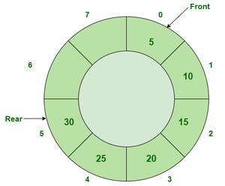
Circular Queue
Circular Queue is an extended version of a normal queue where the last element of the queue is connected to the first element of the queue forming a circle.
Circular queue follows FIFO principle. Queue items are added at the rear end and the items are deleted at front end of the circular queue

Slide 3
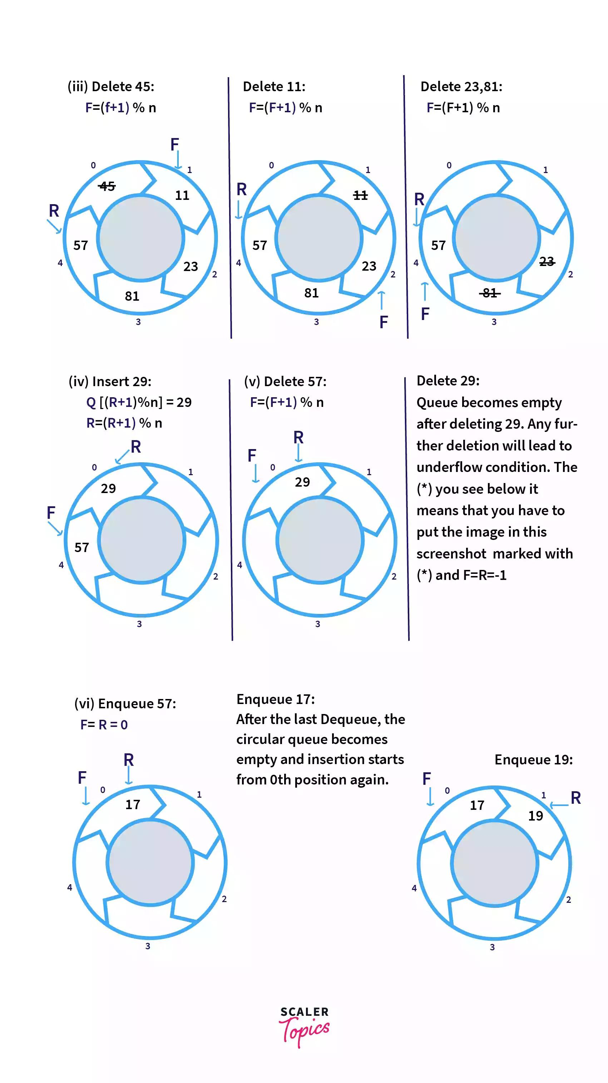

Slide 4
Circular Queue
In Circular Queues we utilize memory efficiently,because in queue when we delete any element only front increment by 1, but that position is not used later.
So when we perform more add and delete operation, memory wastage increase. But in Circular Queue memory is utilized, if we delete any element that position is used later, because it is circular.

Slide 5
Circular Queue
In a linear queue with max. Size 5, after inserting element at the last location (4) of array, the elements can’t be inserted, because in a queue the new elements are always inserted from the rear end, and rear here indicates to last location of the array (location with subscript 4) even if the starting locations before front are free. But in a circular queue, if there is element at the last location of queue, then we can insert a new element at the beginning of the array.
REAR=(REAR + 1) % MAXSIZE.
FRONT = (FRONT + 1) % MAXSIZE.

Slide 6
Priority Queue
Priority queue is a collection of elements where the elements are stored according to their priority levels. The order in which the elements get added or removed is decided by the priority of the element. Following rules are applied to maintain a priority queue : (1) The element with a higher priority is processed before any element of lower priority. (2) If there are elements with the same priority, then the element added first in the queue would get processed.
Priority queues are used for implementing job scheduling by the operating system where jobs with higher priorities are to be processed first.
Priority queues are often used in real-time systems

Slide 7
Properties of Priority Queue
Every item has a priority associated with it. An element with high priority is dequeued before an element with low priority. If two elements have the same priority, they are served according to their order in the queue.

